Slide 1
Smart Agriculture system based on IoT
A better solution for better future

Slide 2
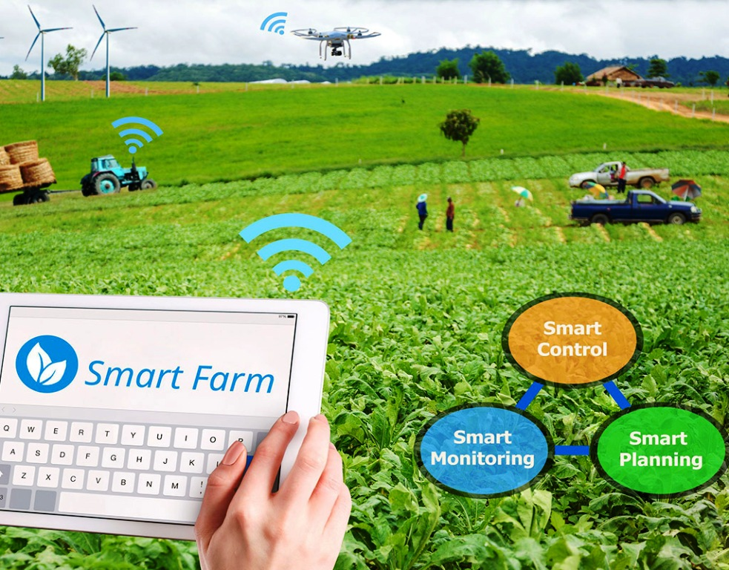
Why iot in agriculture ?
The farming and agricultural industry relies on innovative ideas and technological advancements to help increase yields and better allocate resources. The late 19th century and the 20th century brought a number of mechanical innovations, like tractors and harvesters. Today, a driving force behind increased agricultural production at a lower cost is the Internet of Things (IoT), which leaves the door wide open for engineers looking to bring a smart farming solution or IoT agricultural sensor to market.

Slide 3
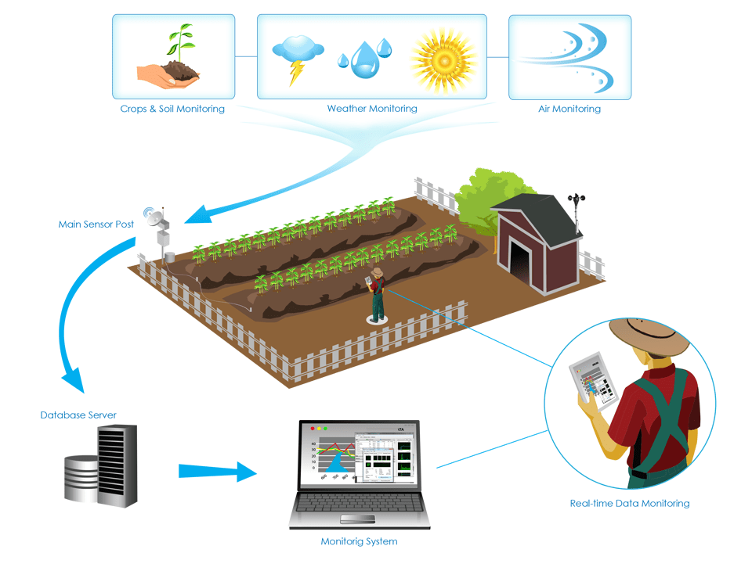
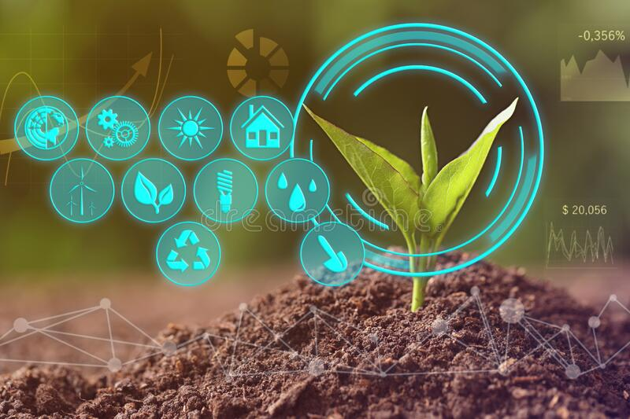
The project
This project can monitor soil moisture and climatic conditions to grow and yield a better crop. The farmer can also get the real time weather forecasting data by using external platforms like Open Weather API. Farmer is provided a web application using which he can monitor the temperature, humidity and soil moisture parameters along with weather forecasting details.
Based on all the parameters he can water his crop by controlling the motors using the application as per requirement without his physical presence at the crop. And based on the weather data obtained he can predict the weather and take required measures to avoid loss due to undesirable climatic conditions

Slide 4
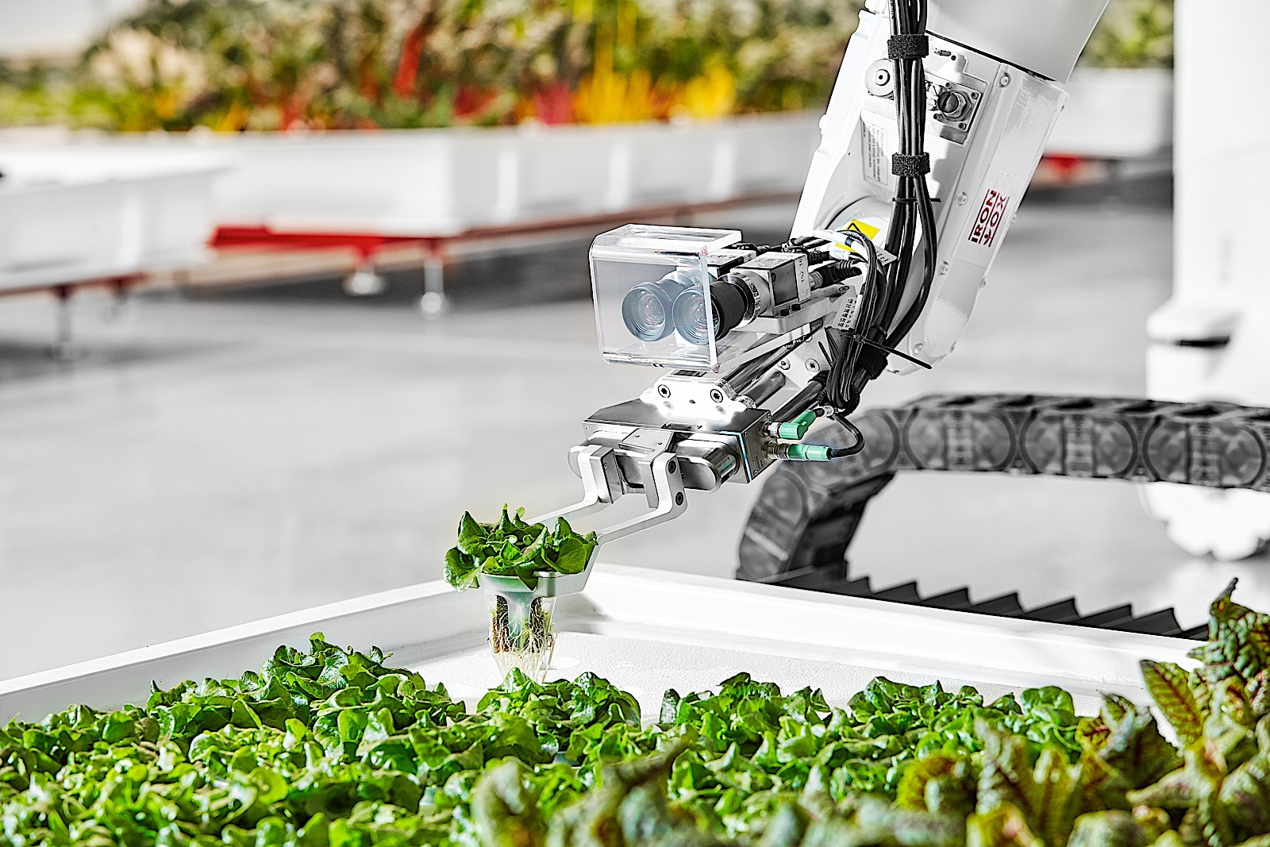
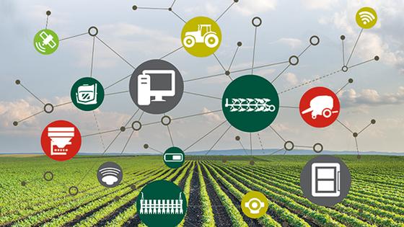
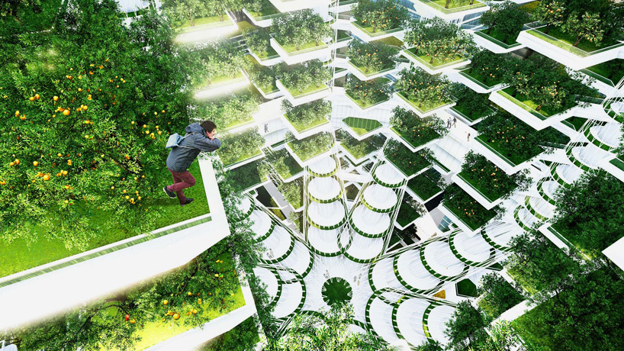
Future scope
Future work would be focused more on increasing sensors on this system to fetch more data especially with regard to Pest Control and by also integrating GPS module in this system to enhance this Agriculture IoT Technology to full-fledged Agriculture Precision ready product. Integrating it with Ai devices to automate planting and other functionalities.

Slide 5
If it weren’t for agriculture, there would be no culture at all
thankyou

